Slide 1
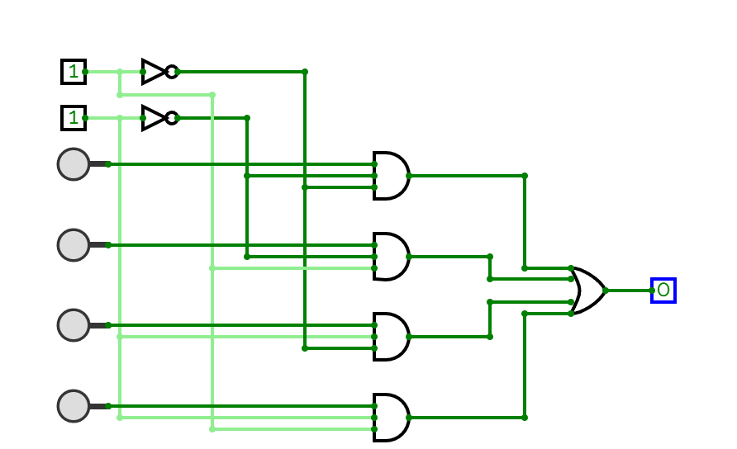
Design and Simulation of a Multiplexers by Logic Gates using Verilog HDL

Slide 2
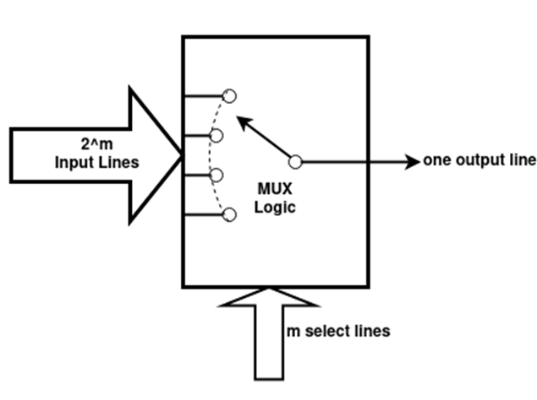
Introduction
A Multiplexer (MUX) is a combinational circuit that selects one input from multiple inputs and forwards it to a single output line.
Let us, Design a 4:1 Multiplexer Using Logic Gates
Inputs: I₀, I₁, I₂, I₃
Select lines: S₁, S₀
Output: Y
S1 | S0 | Y
0 | 0 | I0
0 | 1 | I1
1 | 0 | I2
1 | 1 | I3

Slide 3
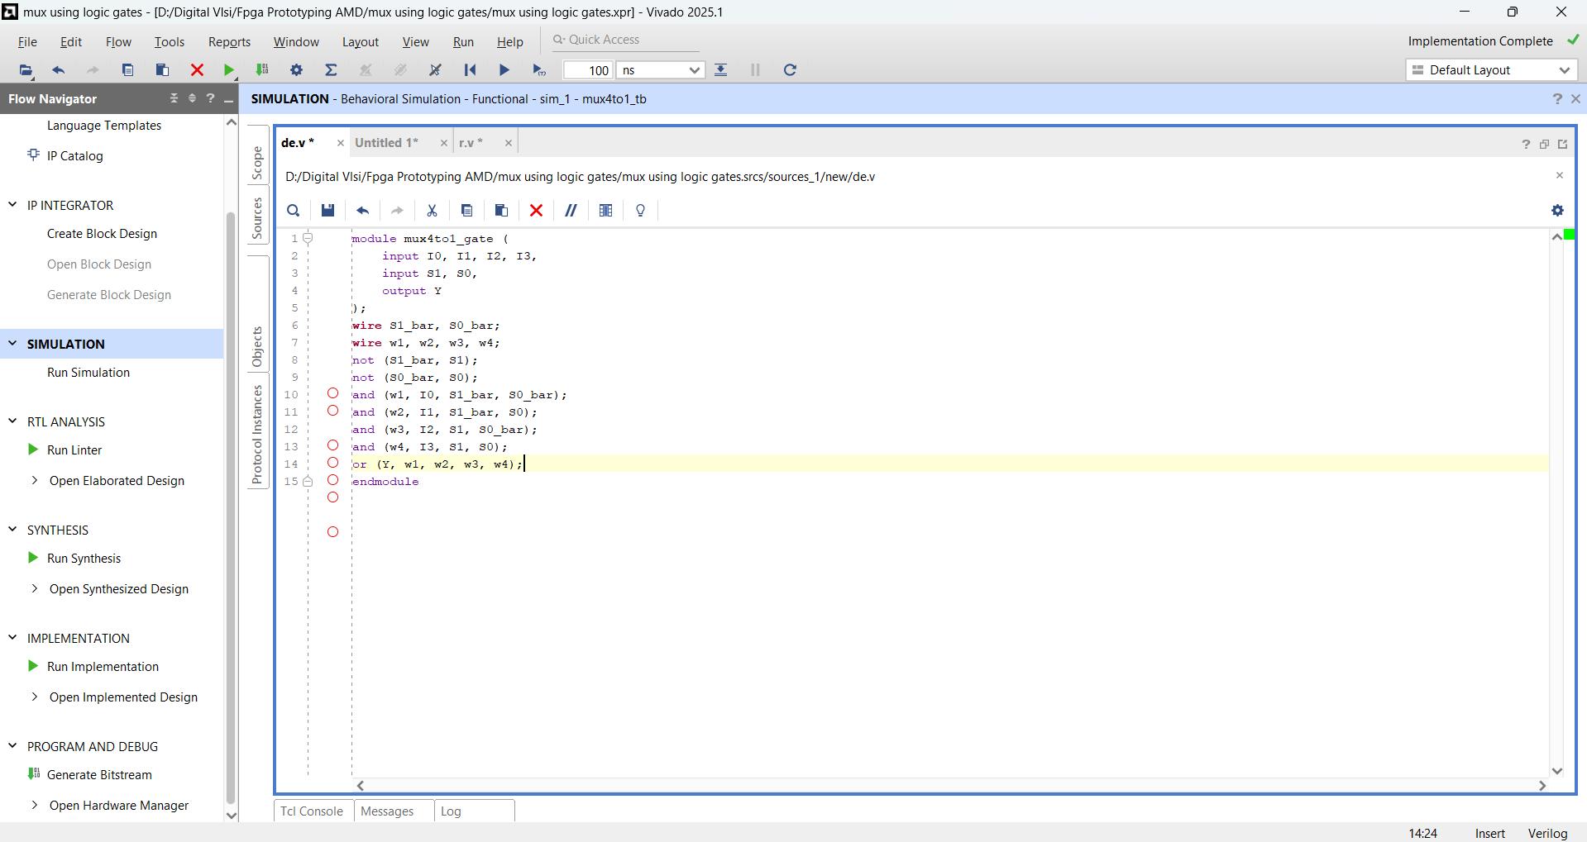
Design

Slide 4
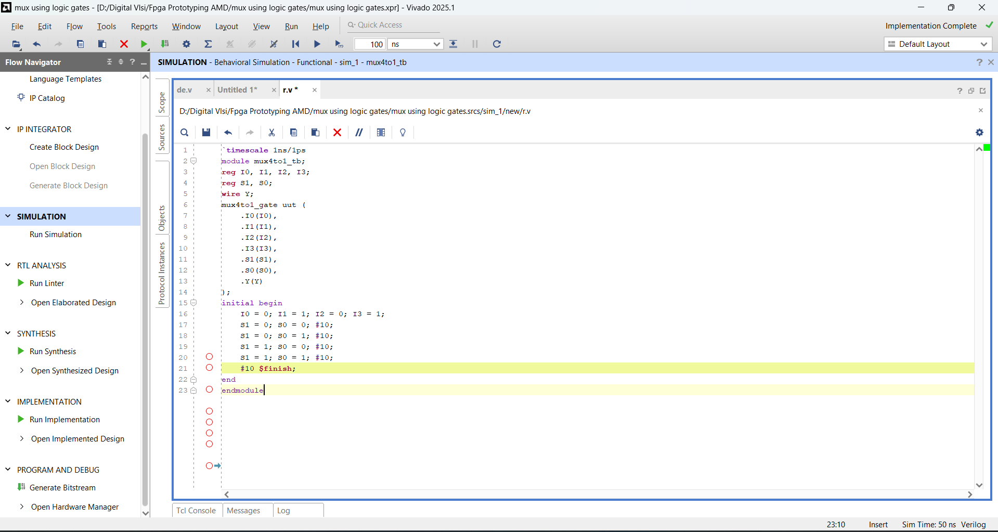
Testbench

Slide 5
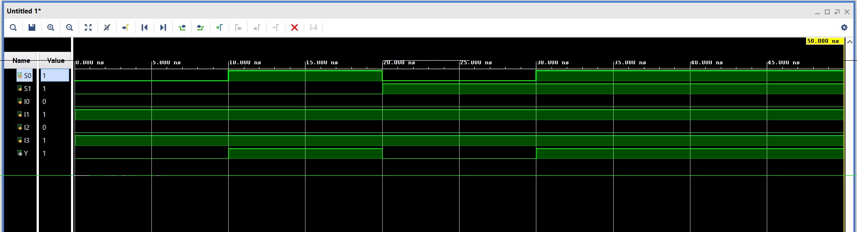
Waveform

